Slide 1



Presented By | Bannari Shankar Jayaraman
Registration ID | RPACULT203
Team Name | Team Kafkaesque
Team Members | RPACULT216(Arshad Fazil)

Slide 2

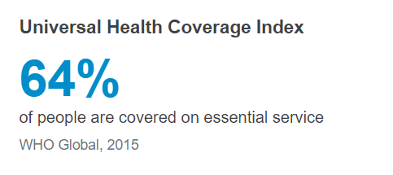
Health insurance
According to WHO

Slide 3
Health insurance Claim Types
Cashless Claim
Networked hospital treatment
Submission of Preauth prior to planned treatment
Submission of Preauth within 24 hours for emergency cases
No spending from insured pocket
Reimbursement claim
Non- network hospital treatment
Pay from insured pocket
Submit the discharge summary and required documents
Get money reimbursed

Slide 4
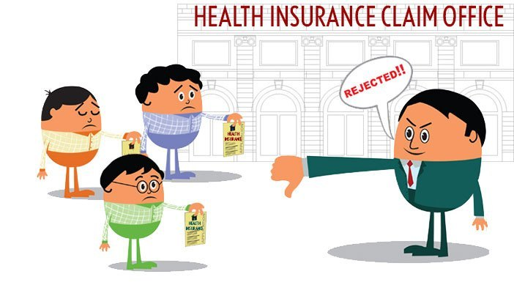
Risks in Cashless
Hospital has more responsibility to get claim approved
Rejected claims are risk to insured.
Disputes between hospital and insured
Rejected claims impact the insurance company’s settlement ratio and incurred ratio

Slide 5
Preauth Forms
Details required by the insured
Details of primary insured
Details of insurance history
Details of insured person hospitalized
Details of hospitalization
Details of doctor
Bill details

Slide 6

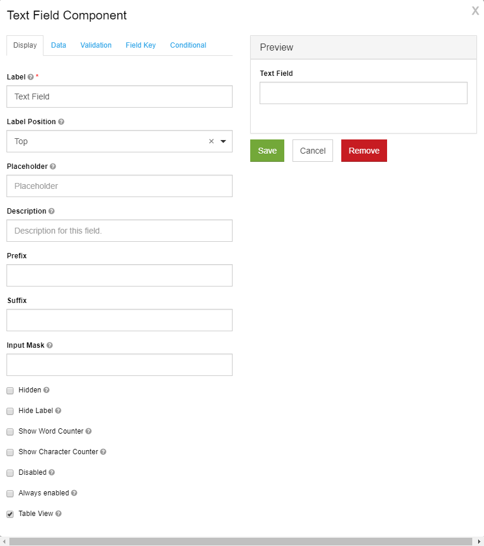




Cashless claim – uipath form

Slide 7
BENEFITS OF AUTOMATION
Single form tailored for multiple insurance companies
Consolidated data, reports, mails can be send to various insurance companies
Online claim submission in web portal can be done if required.
Validations for fields can be incorporated

Slide 8
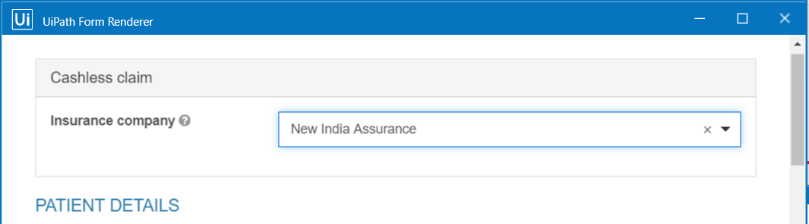
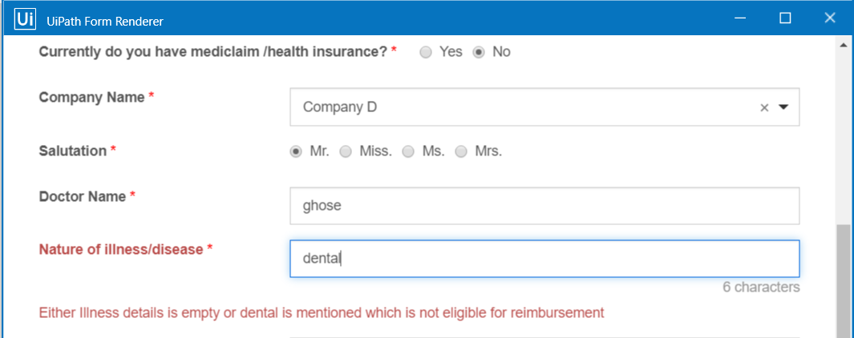
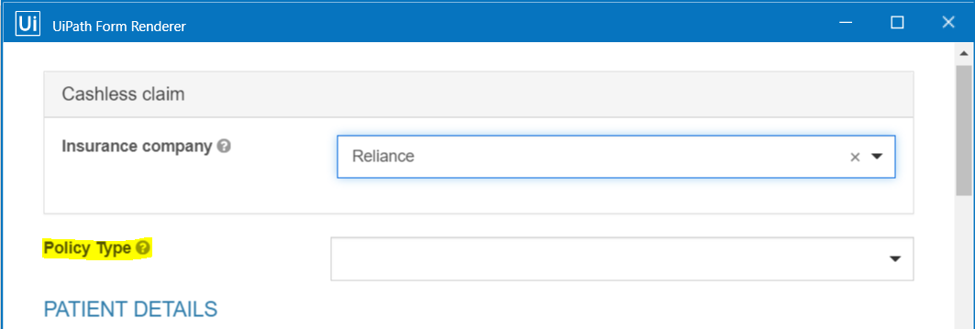
Cases handled in solution
Single form tailored for multiple insurance firm
Validation of possible rejection scenarios

Slide 9


